Slide 1
Interesting special effects on color images
Student: Bradea Maria Mihaela
Image Processing, 2024

Slide 2
1. Introduction
Color images form an integral part of modern digital media, ranging from photographs to digital artwork. Enhancing these images with special effects adds depth, vibrancy, and artistic expression. This document outlines the theoretical background, bibliographical study, methods, and possible solutions for implementing interesting special effects on color images using OpenCV.

Slide 3
2. Bibliographical study
Explored various techniques including filters, transformations, and enhancements.
Identified key papers, algorithms, and methodologies relevant to the study.
Examined seminal works in image processing and computer graphics.
Leveraged insights from research articles, academic papers, and industry publications.
Identified trends, advancements, and challenges in the field of color image manipulation.

Slide 4
3. Methods
Image Processing Techniques:
Utilized OpenCV, a popular open-source computer vision library, for implementing special effects.
Study of fundamental image processing techniques such as filtering, blending, and transformation.
Color space manipulation:
Explored different color spaces (RGB, HSV, LAB, etc.) for manipulating color information.
Investigated techniques for adjusting hue, saturation, brightness, and contrast to achieve desired effects.

Slide 5
Filtering and Convolution:
Applying convolution operations to modify pixel values and create artistic effects.
Possible solutions:
Color Gradients:
Implementing gradient-based effects to add depth and dimensionality to color images.
Exploring techniques for generating smooth transitions between colors using gradient maps and blending modes.
Color Manipulation:
Exploring color harmonization, color transfer, and color grading for artistic enhancement.
Chosen solution:
- Oil Painting: The testOilPaintEffect simulates an oil painting by creating histograms for pixel intensity within a neighborhood and selecting the most frequent intensity as the newpixel value. This demonstrates a non-linear filter application, which is more complex than standard linear filters like Gaussian blur.

Slide 6
Sepia Tone: The applySepiaEffect function applies a classic sepia tone to an image, simulating an old-fashioned photograph by manipulating RGB values according to fixed coefficients that mimic the sepia effect.
Functions like testMosaicEffect and testOilPaintEffect apply more complex and computationally intensive transformations. Mosaics average out blocks of pixels, while oil paint effects consider the most common colors within a pixel's neighborhood, both creating distinctive artistic effects.
Pencil Sketch: This effect uses a combination of inversion and Gaussian blur to create a hand-drawn look.
Psychedelic Glitch: Introduces randomness in color channel shifts and adds visual noise, creating a distorted and visually striking effect.

Slide 7
Algorithms and techniques:
Gaussian Blur: Applies a Gaussian blur filter, which is used to reduce image noise and detail by using a Gaussian function, helping in the preprocessing step for edge detection.
Canny Edge Detection: A popular edge-detection algorithm that uses a multi-stage process to detect a wide range of edges in images. This algorithm involves filtering the image with a Gaussian, finding intensity gradients, and applying non-maximum suppression and hysteresis thresholding.
Mosaic Effect: Averages the colors within defined blocks or tiles of the image, effectively reducing the resolution of those areas, which simulates a mosaic artwork.
Cross Waves Pattern: Alters pixel positions based on sinusoidal functions to create wave patterns, demonstrating the use of mathematical models in image manipulation.

Slide 8
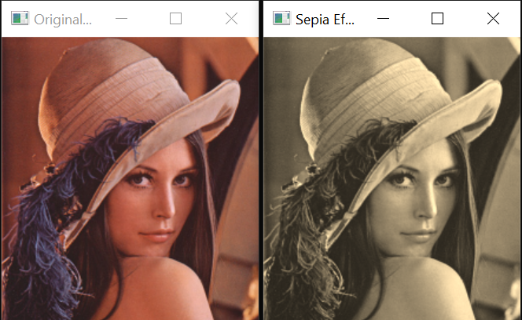
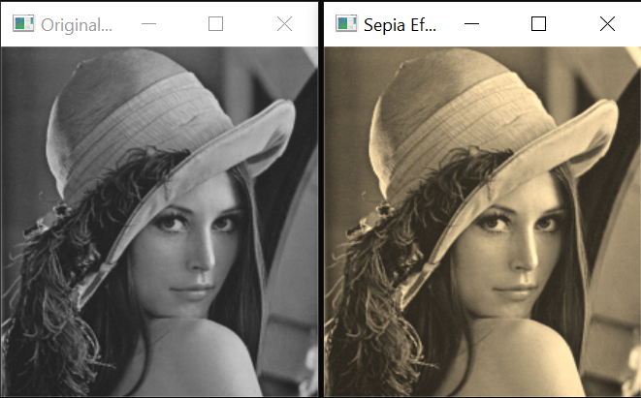
4. Experimental results 4.1 Sepia effect

Slide 9
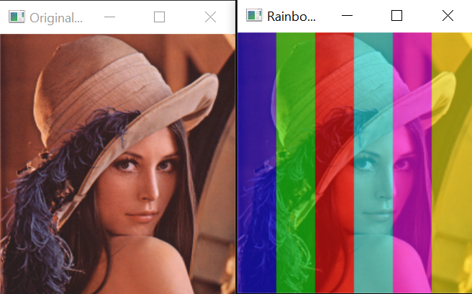
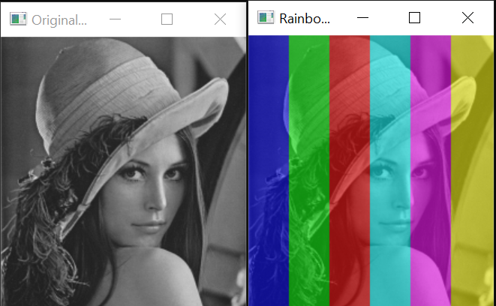
4.2 Rainbow effect

Slide 10
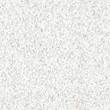
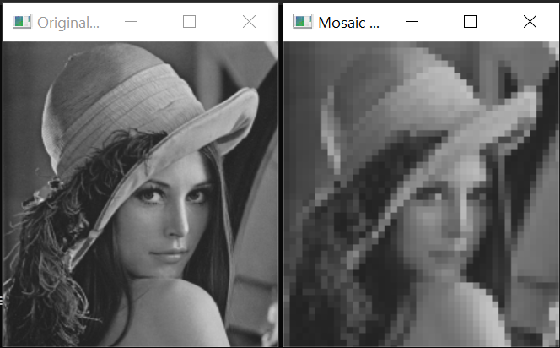
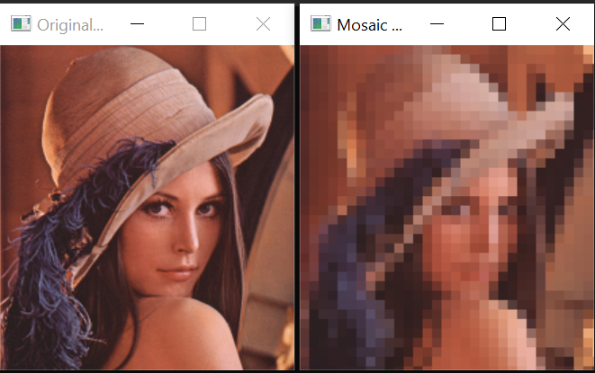
4.3 Mosaic effect

Slide 11
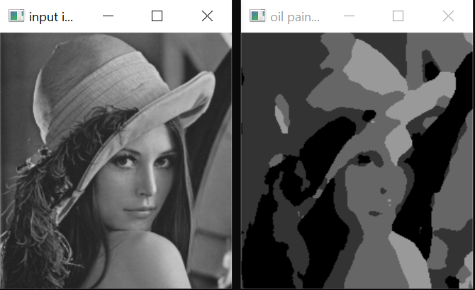
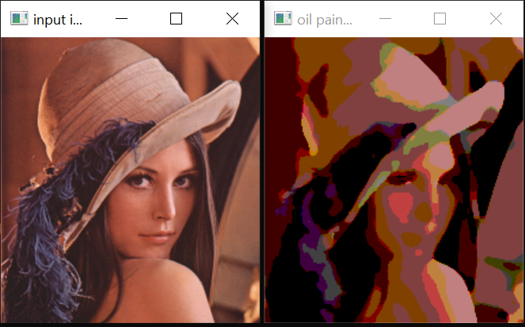
4.4 Oil painting effect

Slide 12
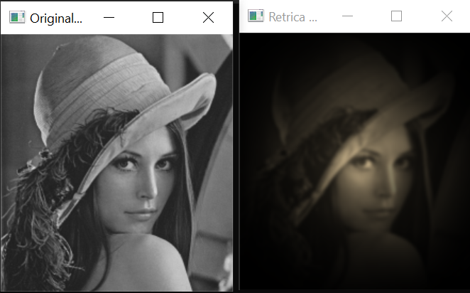
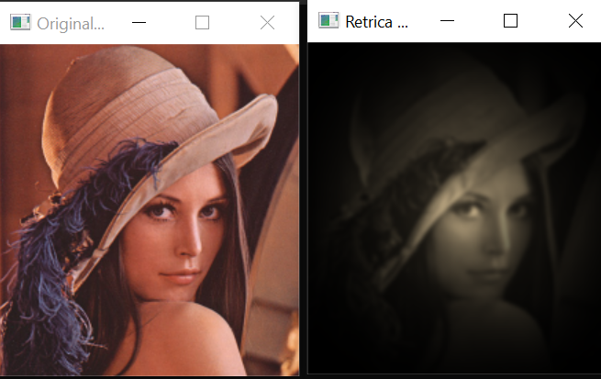
4.5 Drama effect with vignette

Slide 13
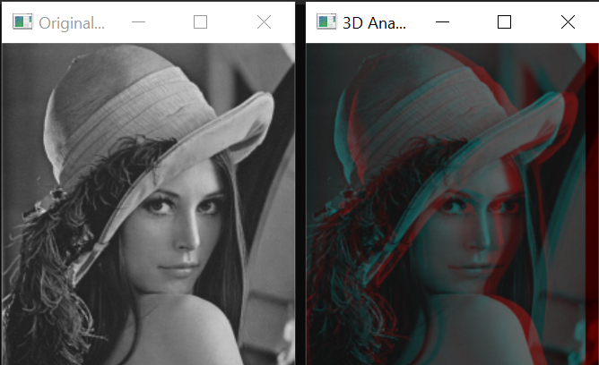
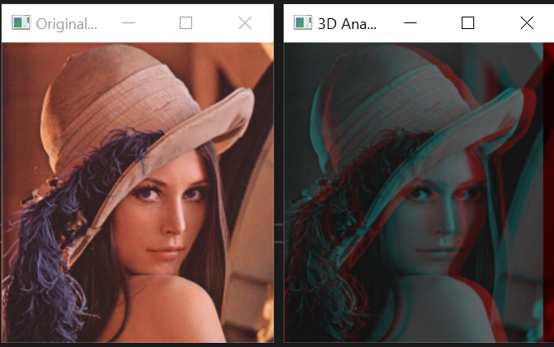
4.6 Glass anaglyph effect

Slide 14
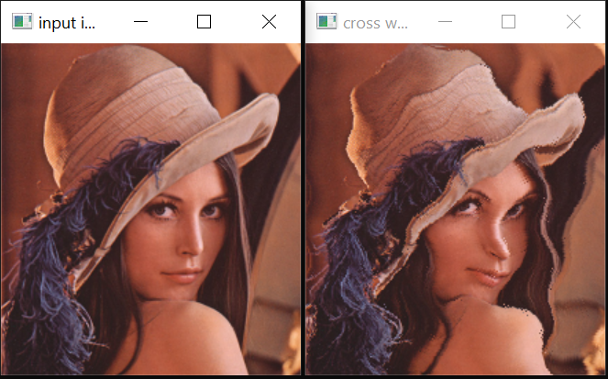
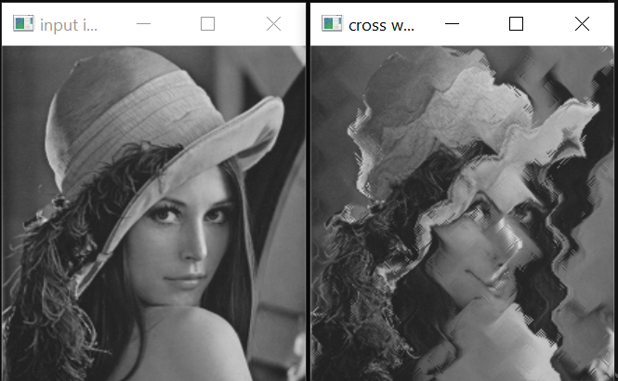
4.7 Cross waves effect

Slide 15
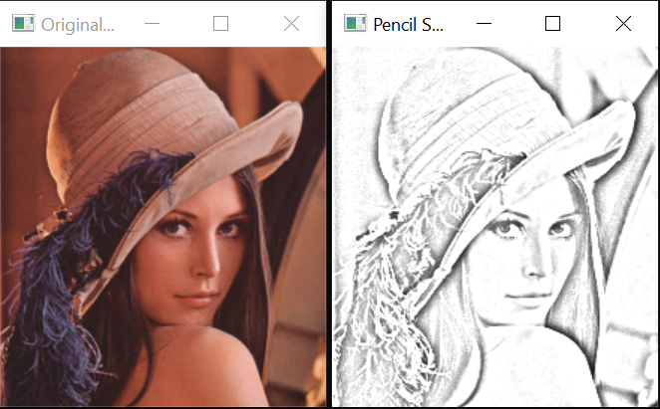
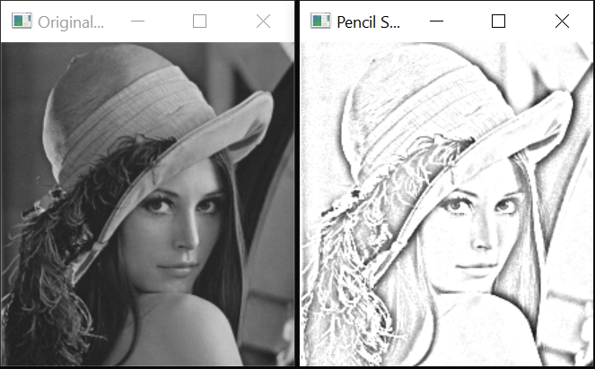
4.8 Pencil sketch effect

Slide 16
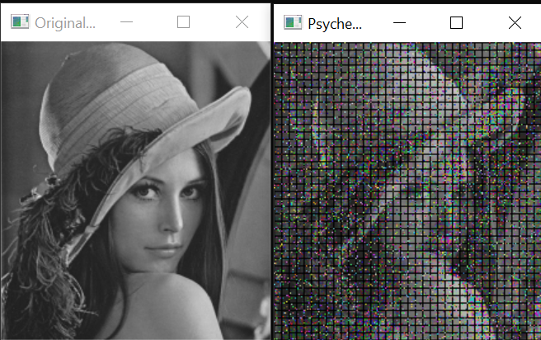
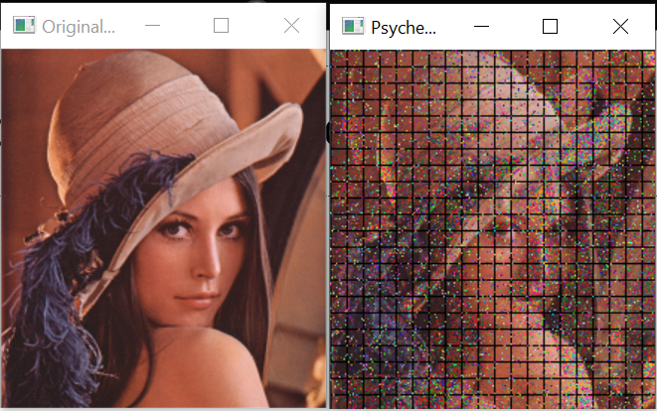
4.9 Psychedelic glitch effect

Slide 17
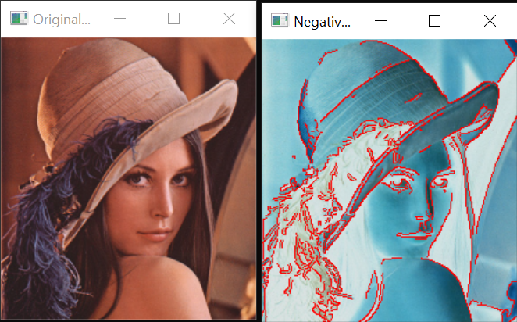
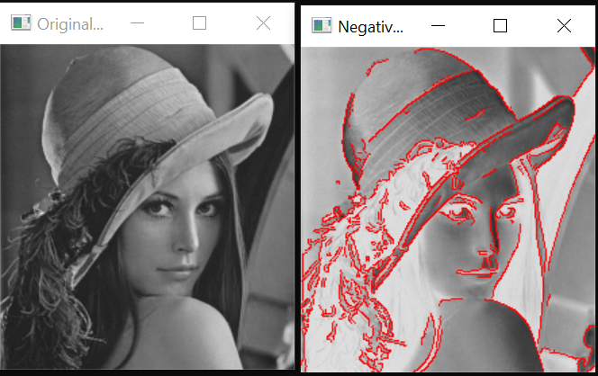
4.10 Negative with red edge effect

Slide 18
5. Conclusions
The project successfully implemented a variety of image processing techniques using the OpenCV library, demonstrating the capability to handle and manipulate images in numerous ways. The objectives of showcasing basic to advanced image manipulations were achieved through a variety of functions:
Basic Image Operations: Functions like image display, reading, writing, and conversions between color spaces provided foundational skills in image processing.
Advanced Effects and Algorithms: Implementation of complex effects such as the oil painting effect, mosaic effect, and 3D anaglyph demonstrated advanced understanding and application of both algorithmic and creative aspects of image processing.

